Slide 1
What is Geolocation?
The HTML Geolocation API is used to locate a user's position.
Locate the User's Position
The HTML Geolocation API is used to get the geographical position of a user.
Since this can compromise privacy, the position is not available unless the user approves it.
Geolocation is most accurate for devices with GPS, like smartphone.

Slide 2
Using HTML Geolocation
getCurrentPosition()
This method is used to return the user's position.
Handling Errors and Rejections
The second parameter of the getCurrentPosition() method is used to handle errors. It specifies a function to run if it fails to get the user's location.
function showError(error) { switch(error.code) { case error.PERMISSION_DENIED: x.innerHTML = "User denied the request for Geolocation." break; case error.POSITION_UNAVAILABLE: x.innerHTML = "Location information is unavailable." break; case error.TIMEOUT: x.innerHTML = "The request to get user location timed out." break; case error.UNKNOWN_ERROR: x.innerHTML = "An unknown error occurred." break; } }

Slide 3
Cont. Geolocation
Geolocation is also very useful for location-specific information, like:
Up-to-date local information
Showing Points-of-interest near the user
Turn-by-turn navigation (GPS)

Slide 4
Geolocation Object - Other interesting Methods
watchPosition():
Returns the current position of the user and continues to return updated position as the user moves (like the GPS in a car).
clearWatch():
Stops the watchPosition() method.

Slide 5
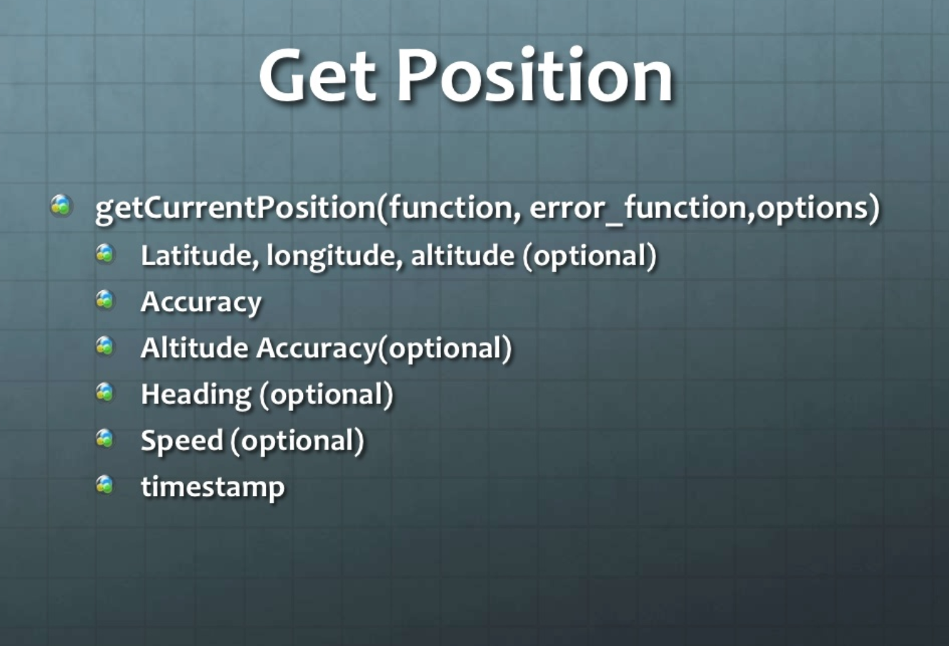

Slide 6
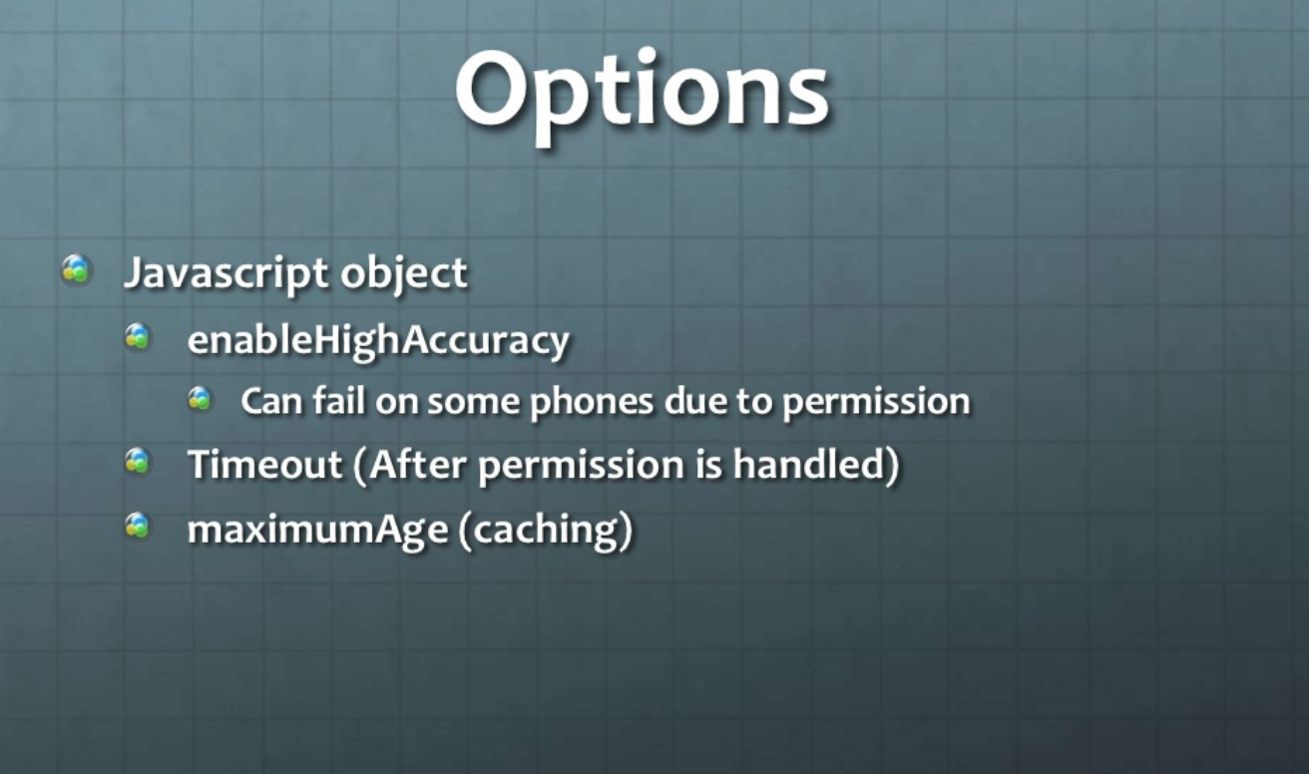

Slide 7
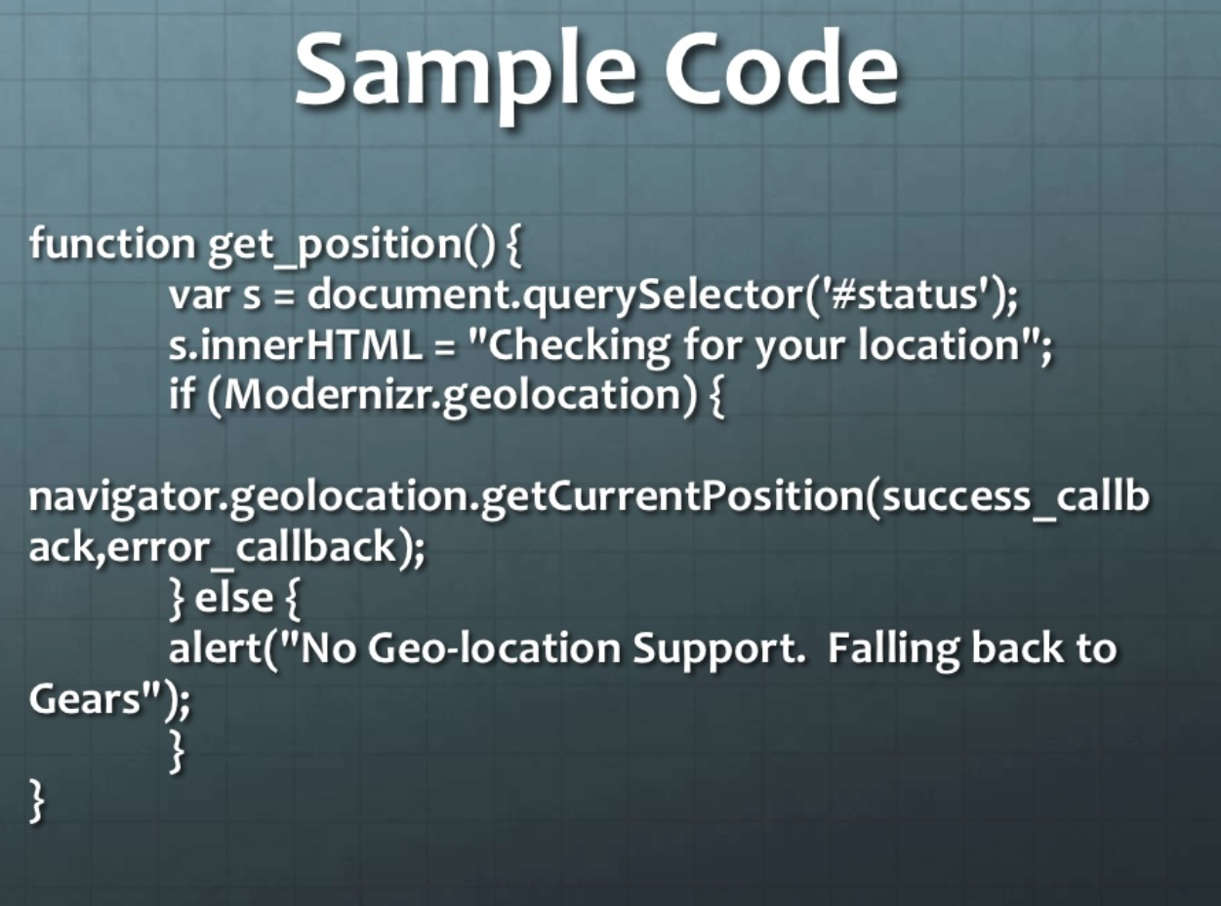

Slide 8
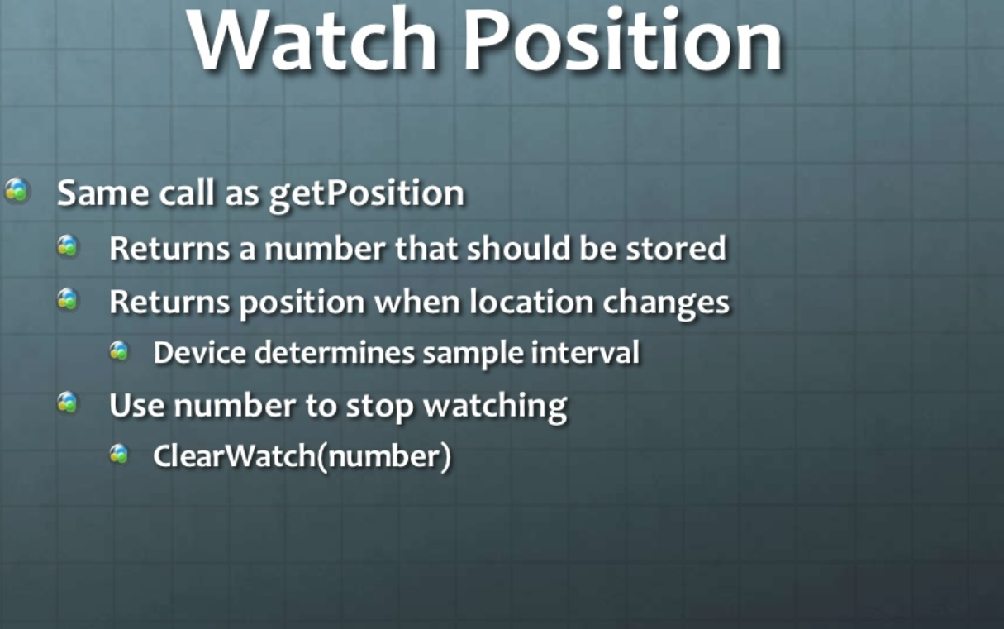

Slide 9
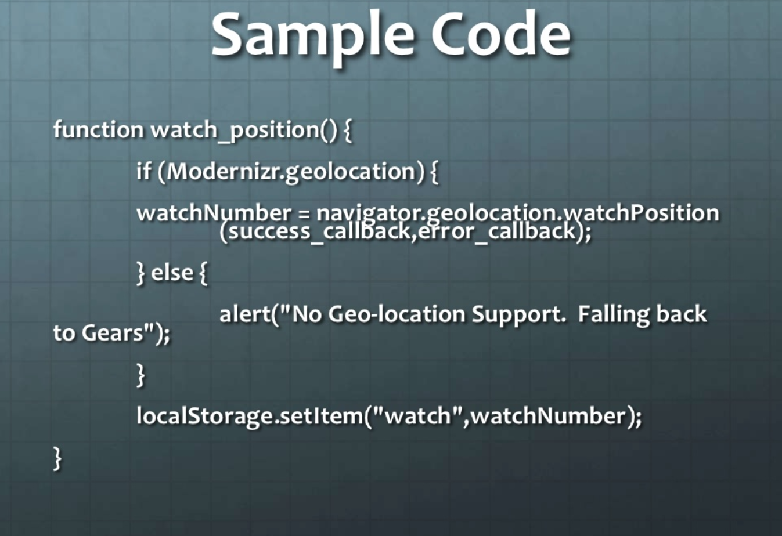

Slide 10
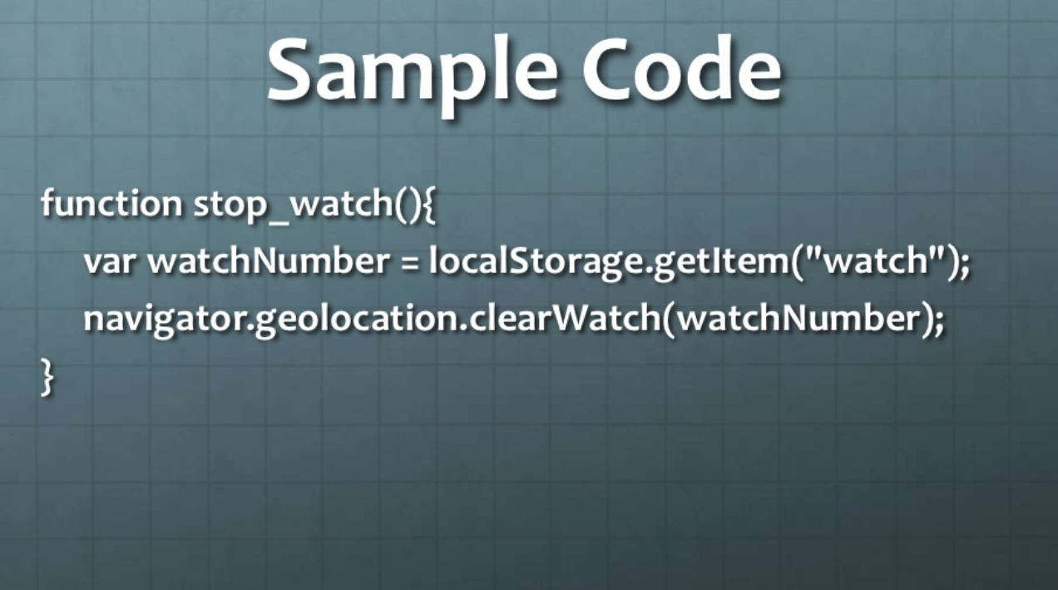

Slide 11


Slide 12
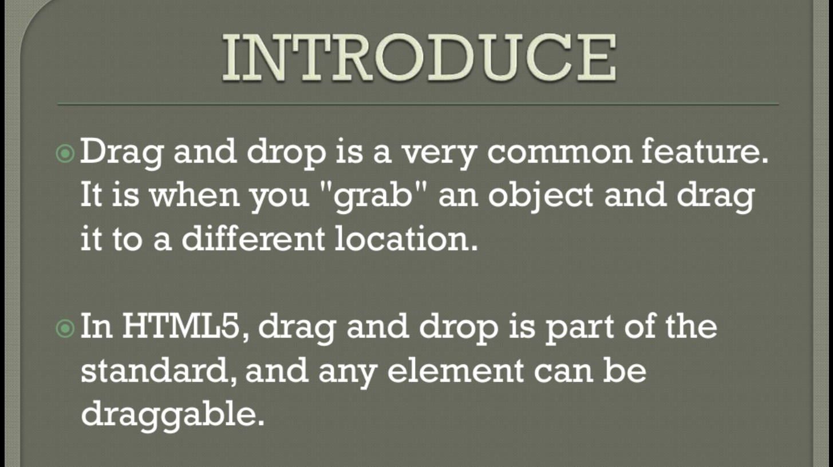

Slide 13
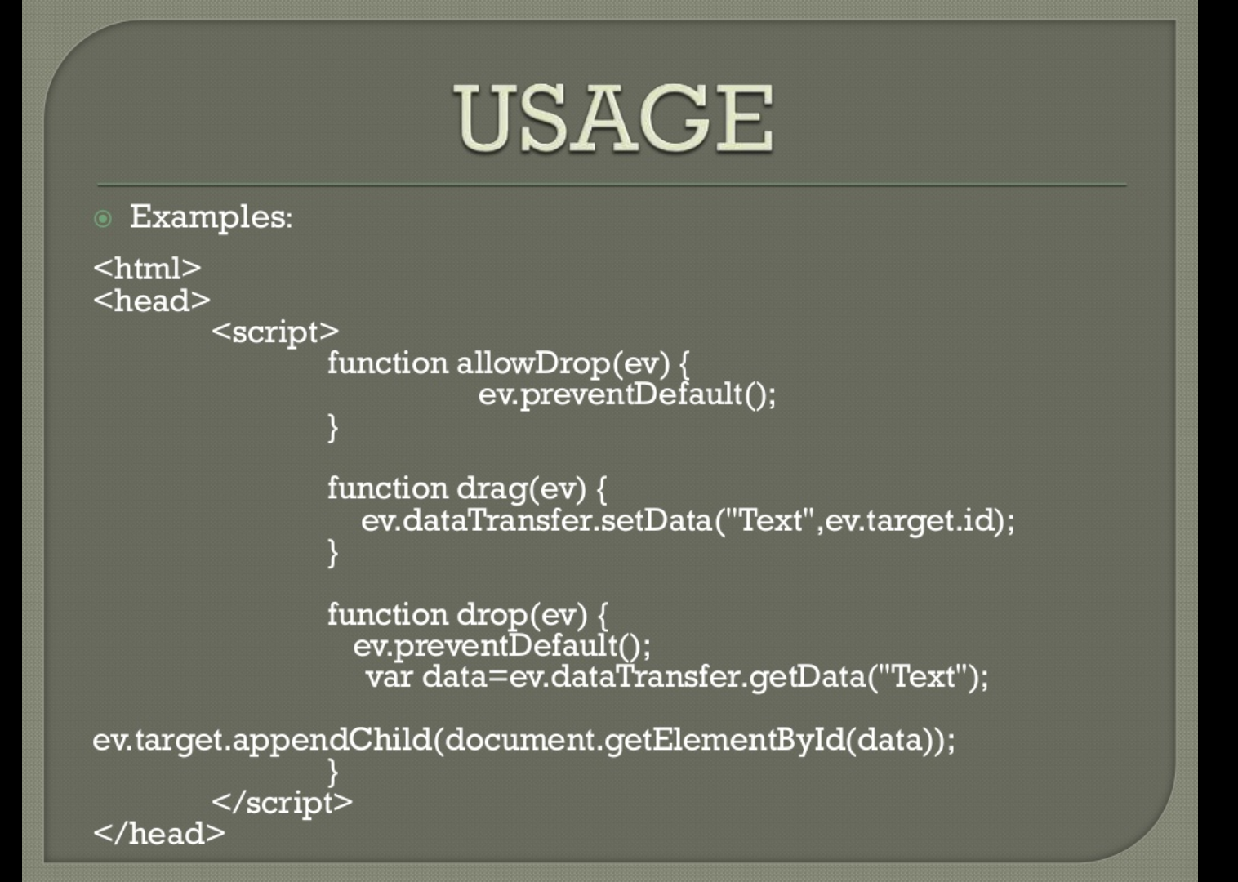

Slide 14
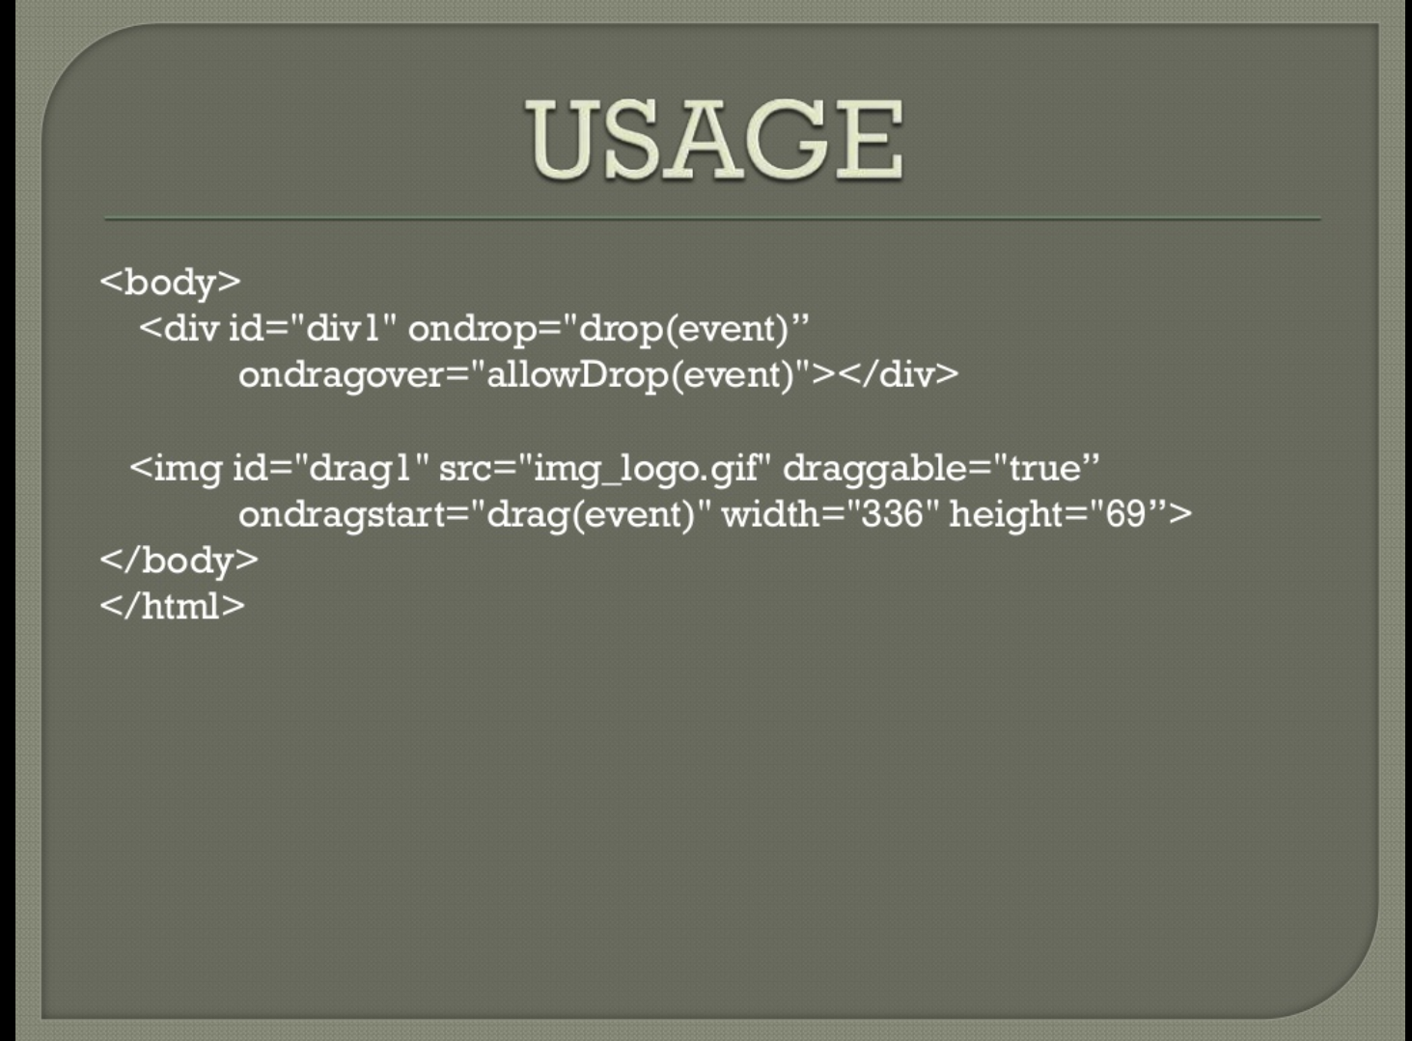

Slide 15
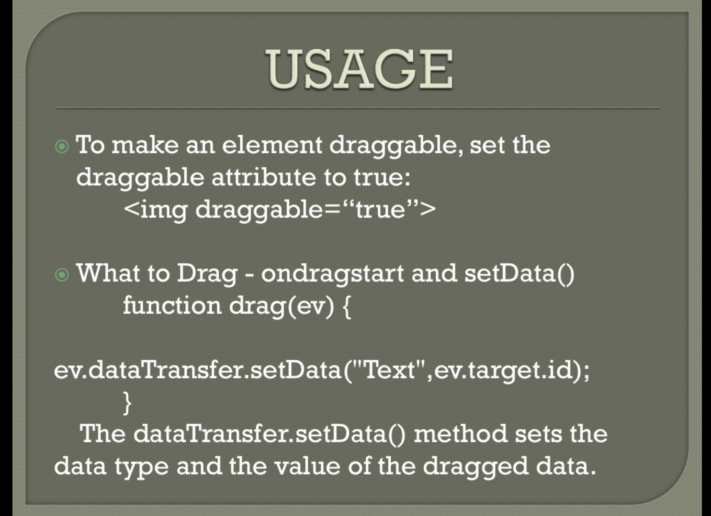

Slide 16
